Slide 1

Lecture 6: User Interface (UI) & Event-driven Programming
WRPV301: Advanced Programming
Dr Simone Beets
Notes:
http://docs.oracle.com/javase/8/javase-clienttechnologies.htm

Slide 2
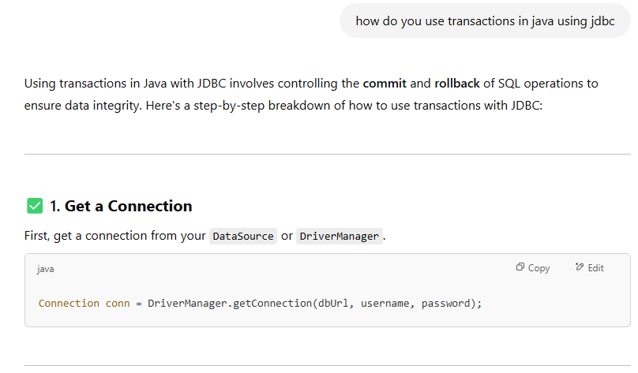
Notes:
ChatGPT screenshots on how to use transactions in java

Slide 3
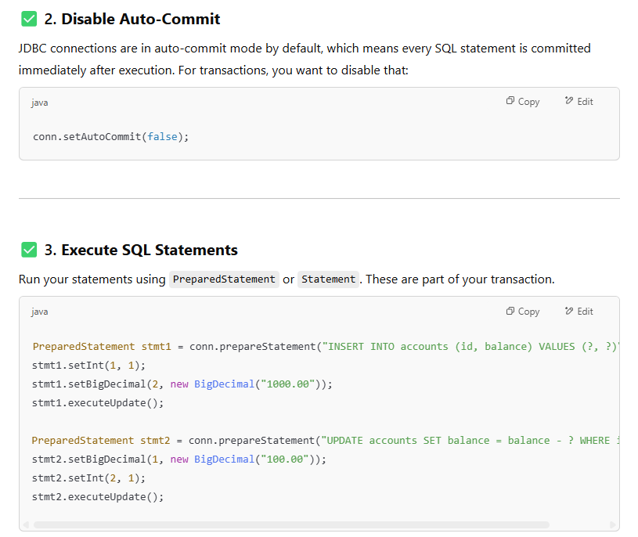
Notes:
ChatGPT screenshots on how to use transactions in java

Slide 4
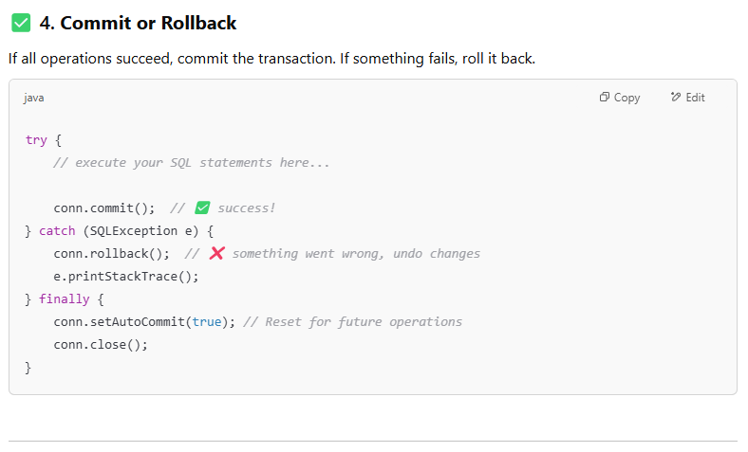
Notes:
ChatGPT screenshots on how to use transactions in java

Slide 5
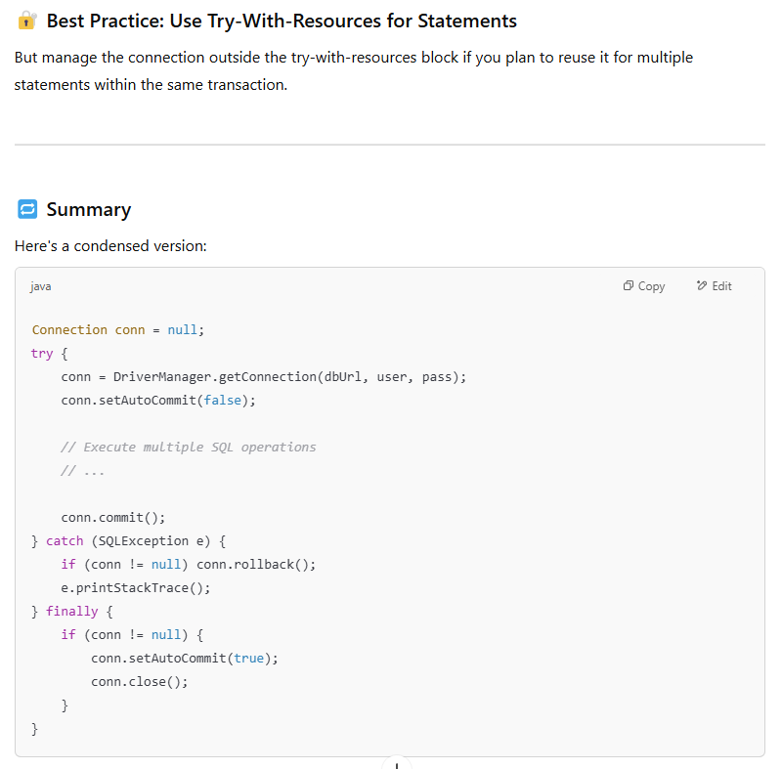
Notes:
ChatGPT screenshots on how to use transactions in java

Slide 6

UI & event-driven programming
http://docs.oracle.com/javase/8/javase-clienttechnologies.htm

Slide 7
Introduction
Event-driven programming
Different types of controls
UI creation
Events & handling
Examples
UI & event-driven programming

Slide 8

Can you think of a UI or application that is well-designed? Why?

Slide 9
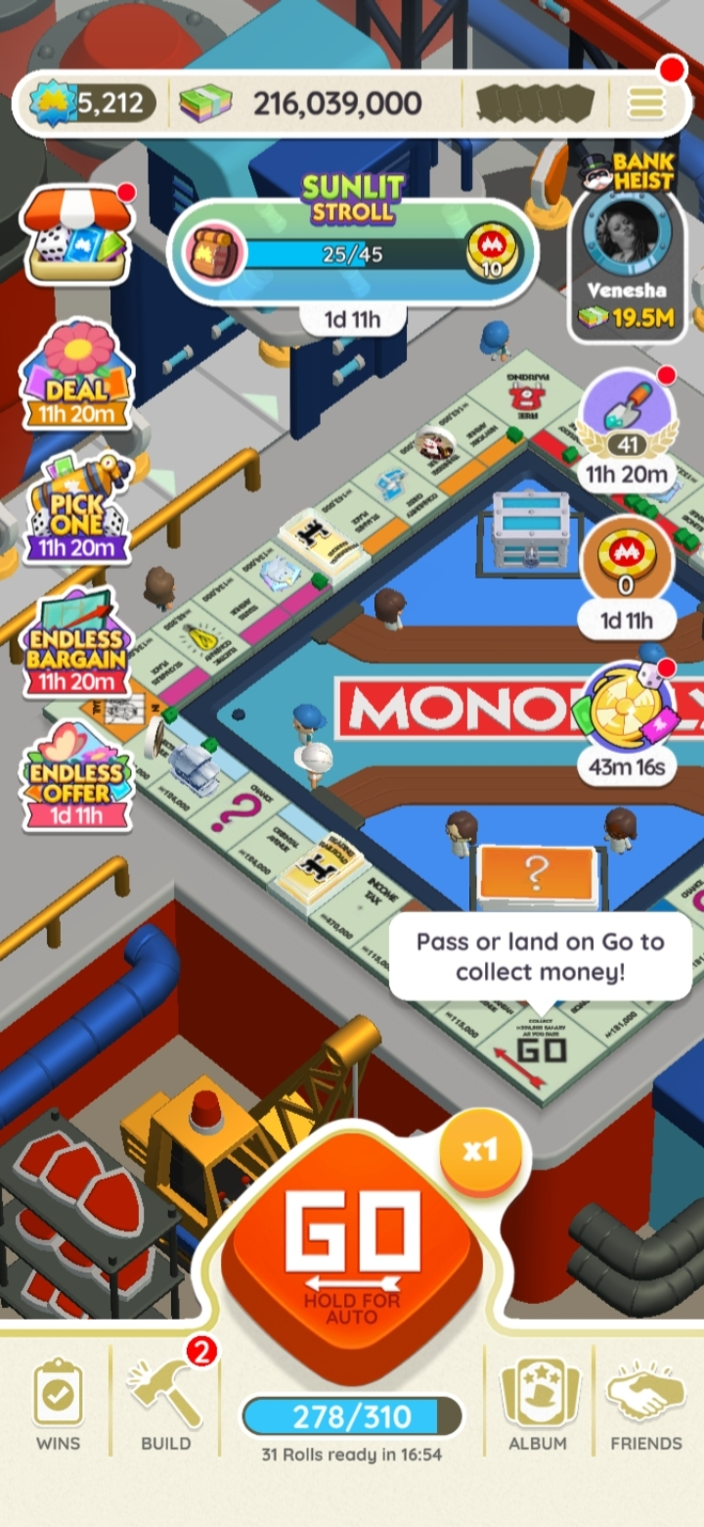
Notes:
Lots of information displayed on screen but doesn’t feel cluttered or overwhelming
Responsive (sometimes delays, but ok)
Can play on repeat by holding in the go button
Some help bubbles on how to play
Lots of rewards as you play (even without making purchases)
Lots of different challenges that expire at a certain time
Can play with friends & against friends
Replicates something that a lot of us (at least me) grew up with → board games, but now kind of in your pocked
Sounds of dice, chance, treasure chest (community chest)
Free items if visit daily like dice, etc.
Good UI design:
Give feedback
Be consistent
Prevent errors
Make things easy to undo
Guide the user (good flow)
Follow the less thinking principle
Prioritise accessibility
Be responsive
Keep it simple
Test with real users
Some bugs
E.g., when getting a reward from Facebook → keeps saying that someone got it already & then gives it to you
+ A little delay on animation
+ lately it gets stuck, so need to restart

Slide 10
Introduction
Graphical User Interfaces (GUIs)
Interaction that is not console-based
i.e., a way of interacting with programs visually
Could use other input devices such as mouse, touch & gestures, voice, etc.
Java has gone through several iterations
Notes:
Q: Who has worked with GUIs before? Not necessarily in Java itself?
Q: And in Java?

Slide 11
Introduction
AWT
SWING
JavaFX
Abstract Window Toolkit
OS controls wrapped in Java classes
Considered heavy weight
Look & feel of native OS was running on
Lowest-common-denominator GUIs created
Java-only UI
Own look & feel
Advanced controls
Considered light weight
Latest incarnation of Java UI tools
Uses data-binding
Very flexible i.t.o. operations that can be performed
UI effects, layouts
Can load layouts from XML
Uses FXML
Can use CSS to change look of a GUI
Notes:
AWT
Heavy weight: AWT components depended on the system, were slower to render & were harder to manage consistently
Look & feel of native OS
(because was the native controls)
Apps looked different according to the OS, e.g., a Windows button
Lowest-common-denominator GUIs created
Limited to common support among all OSs
Couldn’t make advanced/custom GUIs easily – had to work on everything
SWING
Came later
Java-only UI
All UI components were created from scratch in Java
Not rely on the OS – drew them itself
Own look & feel
Swing handled rendering → Java programs had a consistent look across platforms
Advanced controls
Provided more complex & powerful UI components → tabbed panes, tables, trees, etc. that AWT did not support
Considered light weight
Not rely on OS components → lightweight
Easier to manage in a cross-platform env. (also sometimes did not feel as native)
JavaFX:
Newer & more powerful GUI FW
Data-binding:
Can link UI components to data sources (e.g., variables or objects) → data changes, UI updates automatically
Load layouts from XML
Can define UI in XML files using FXML (like HTML defines a web page structure)
Separates UI layout from logic (clean and maintainable)
FXML like HTML for JavaFX
Also:
Initially you will be required to create GUIs by hand, later you can choose
Many built-in controls, works with SWING
Controls: like charts, tables, sliders, etc.
Integrate with SWING code → can support legacy systems
3D graphics, printing support, multi-touch support
Summary:
AWT: basic, OS-dependent, clunky
Swing: more powerful & customizable
JavaFX: modern, flexible & powerful (advanced UI design with various features)

Slide 12
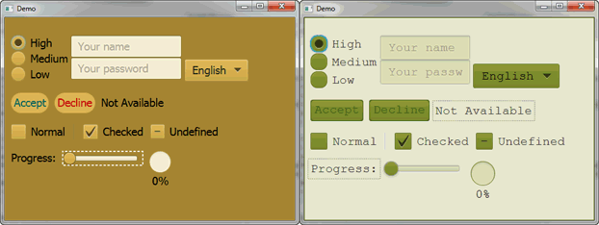
JavaFX
CSS: Cascading Style Sheets
http://docs.oracle.com/javase/8/javafx/get-started-tutorial/jfx-architecture.htm
Notes:
Can use CSS to change look of a GUI on previous slide:
Can see two different CSS styles applied to the same set of UI controls here
Q: who used CSS before?
Q: who can tell us what it is?
Cascading style sheets → CSS
Apply customised styling to the UI of the JavaFX application without changing any of the application’s source code

Slide 13
Event-driven programming
Similar in concept to menu-based console applications
Infinite loop
Do something when specific event occurs
Only exit program when quit option chosen by user (or crashes)
Typical event-driven application
Starts up & goes into infinite loop (not typically written by programmer)
Does something when interesting event occurs (e.g., click a specific button)
Stops running when user closes application
Notes:
Where you wait for user input, then act based on what the user’s chooses
By infinite loop:
Waits for events (clicks or typing, etc.)
Only does something when something happens
Handles the event and then goes back to waiting
→ usually handled by JavaFX FW (don’t have to write yourself)
So event-driven examples:
When the user clicks a button → do something
When the mouse moves → highlight something
When text is entered → validate
Event-driven:
Starts up & builds the GUI
Enters an invisible, FW-managed loop
Waits for something to happen like a user interaction
Then responds to that interaction using code you’ve written (from an event handler)
Shuts down only when the user closes the application (i.e., chooses a quit option)

Slide 14
Structure of a JavaFX UI
Scene Graph
UI is structured like a hierarchical tree of nodes
A node = one visual element of the UI
E.g., button, shape or image
Has an ID, style (how it looks) & bounding volume
Single parent & 0+ children contained within its bounding volume
May contain effects (blur, shadows), opacity, transforms, event-handlers & an application-specific state
Notes:
Bounding volume:
A rectangle (bounding box) → the area the node visually occupies including its children if it has any
Bounding box:
Used to lay out elements for example
Optimise rendering – don’t draw things off-screen

Slide 15
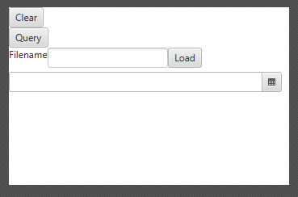
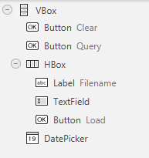
Structure of a JavaFX UI
Stage → area on which a Scene takes place (e.g. a window)
Scene → how Actors are placed & behave on a Stage
Node (Actor) → visual element placed in a Scene
https://docs.oracle.com/javafx/2/scenegraph/jfxpub-scenegraph.htm
http://docs.oracle.com/javase/8/javafx/get-started-tutorial/jfx-architecture.htm

Slide 16
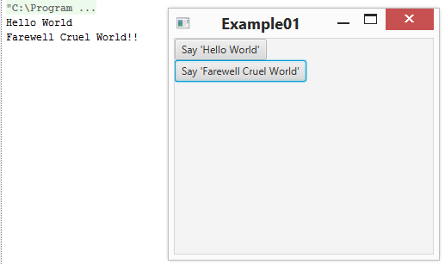
Hello World JavaFX application
Extend the Application class (JavaFX application)
In the overridden start method:
Create controls & layout managers
Set up the scene & add controls/layout managers to the stage
Attach event handlers
Display Scene using the show method
See /Example01
Notes:
Build your UI in the start method → called automatically
Attach event handlers
Like a button click
Remember to add the lib file to project structure – dependencies
VM options – run → edit configurations

Slide 17
Types of Scene Graph Nodes
Controls
Components that allow user interaction (or not)
Buttons, Text Areas, Text Boxes, Labels, List Boxes, Images, Media Players, etc.
Containers
A special type of control that contains other controls
Panels, Grids, etc.
Typically, also Layout Managers (SWING terminology)
Specifies how contained controls are spatially laid out
Pane, VBox, HBox, BorderPane, StackPane, GridPane, FlowPane, TilePane, AnchorPane, TabPane, etc.
http://docs.oracle.com/javafx/2/layout/builtin_layouts.htm

Slide 18
Types of Scene Graph Nodes
Effects
Modifies a control visually
e.g. blur, drop shadow, lighting
Transformations
Alters the scale, orientation or position of a control

Slide 19
Controls & sizing
Each control will have:
Preferred width & height (what we would like to be)
Minimum width & height (will never agree to be smaller than this)
Maximum width & height (will never agree to be larger than this)
Layout managers will size based on these values
Creating certain controls, e.g., Button
Automatically sets preferred, minimum & maximum values
If want to override, then need to manually do so

Slide 20
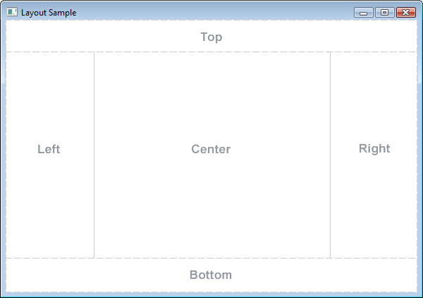
Layouts
VBox / HBox
Lays out children from top-to-bottom (VBox)
or left-to-right (HBox)
No wrapping
FlowPane
Laid out consecutively & wrap at boundary
Can wrap vertically or horizontally
StackPane
Children placed on top of one another (top hides bottom)
BorderPane
Children placed in fixed sized edges or expanding center
See /Example02

Slide 21
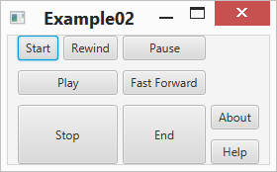
Layouts
GridPane
Creates a flexible grid of rows & columns
Element of a grid called a cell
Nodes can be placed in any cell & may span cells
TilePane
Similar to FlowPane
Equi-sized nodes
AnchorPane
Similar to BorderPane, but contents stick to one side of pane
Pane
Can manually place & size children
See /Example02

Slide 22
Event types
Low-level events
Control gains focus
A key was pressed, released
The mouse was moved, a button pressed or released
The Stage was minimised, maximised, etc.
Button clicked = same as mouse clicked (but on the button)

Slide 23
Event types
High-level events
Composed of low-level events
Examples
Mouse clicked = mouse button down, no mouse movement, followed by mouse button up
Drag = mouse button down, mouse moved, mouse button up
Key tapped = key pressed followed by key released
Button clicked = same as mouse clicked (but on the button)

Slide 24
Java event model
Control
User interacts with, generates events
Can be observed
E.g., button, text box, list box, etc.
Observer (also known as a Listener)
Observes (listens to) a control & responds to events
Handler
The code that is executed in response to an observer observing an event occurring for a specific control

Slide 25
Java event model
When setting up
Who is being observed?
Who is doing the observing? Often called the controller
What is wanted to be observed?
What must be done if what is wanted to be observed is observed?
See /Example03

Slide 26

Java event model
Control being observed
Event being observed for
Event Handler that is run if the Event is observed coming from the Control
// attach event handler to button which triggers when button clicked btnOK.setOnAction(event -> System.out.println("Hello " + txtName.getText())); // attach event handler to text field which triggers when enter is pressed txtName.setOnAction(event -> System.out.println("Greetings " + txtName.getText()));
lbl
txtName
btnOK

Slide 27
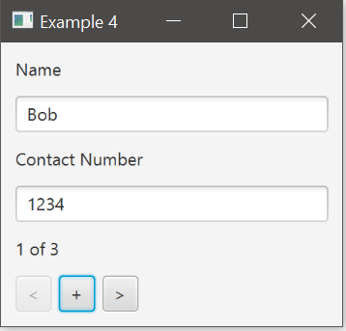
Example: Contact Viewer app
Display one contact at a time
Current Index indicates which contact displayed, -1 if empty list
Previous/Next buttons
Decrement/increment current index
Display “new” current contact details in UI
Display Current Contact
New button
Textfields – user presses enter key, loses focus
See /Example04

Slide 28
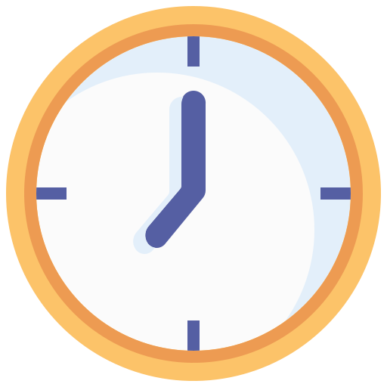
Class exercise
You have 10 minutes…
You have the following:
Label: “Welcome to the App”
TextField: To enter a username
Button: “Login”
Button: “Help”
Divide your page into 2 sections & sketch how these 4 elements would be positioned by JavaFX in the following scenarios:
Sketch A: Vbox with Pos.CENTER
Sketch B: FlowPane with a narrow window (i.e., it can fit 2/3 items)
Then, answer the following: The Login and Help buttons must always appear side by side, regardless of window size. How would you modify Sketch A to achieve this? Draw the updated sketch and name the layout(s) you used.

Slide 29
Assignments
Assignment 2:
Due – tomorrow!
Peer reviews – Friday
ONLY Task 1 extended to Friday
Assignment 3:
Will upload this week
Due – check schedule
Notes:
Self-study lecture after recess
Test 1 – after recess, all same content/format

Slide 30


Notes:
* Self-study lecture after recess

